Slide 1

E-MASTERS PROGRAMME IN COMPUTER SCIENCE: AI & ML · IIIT HYDERABAD
CodeGen
Hybrid RAG Retrieval + LoRA Fine-Tuning
on a Small Code LLM
Team Members(Group 2)
N Anjan Karthik Chandra
Jakka Rithusravya
Darshna Kumawat
Mentor
Mr. Sajid Ansari

Slide 2
§
ABSTRACT
Problem Statement
Natural-language-to-query interfaces are well studied for relational SQL — the Spider benchmark alone underlies hundreds of published systems — but equivalent tooling for MongoDB's document-oriented Query Language (MQL) is nascent: dedicated datasets and frameworks (TEND, Spider, EvoMQL) appeared only in 2025–2026. This project converts Spider into 1,114 natural-language-to-MQL pairs spanning 19 databases and builds a compact pipeline around Qwen2.5-Coder-0.5B-Instruct, combining LoRA fine-tuning (r=16, α=32, full attention + MLP) with a hybrid retriever that fuses dense semantic search (FAISS + BAAI/bge-small-en-v1.5) with structural, MQL-aware feature matching. Evaluated with BLEU, ROUGE, CodeBERTScore, and a token-overlap Response Accuracy metric on a 100-sample held-out set, LoRA fine-tuning alone raises Response Accuracy from 33% to 76% and improves every metric measured, at a cost of roughly 39% additional GPU latency. Retrieval augmentation, evaluated separately across five top-k settings, reduces every metric relative to the fine-tuned baseline — a negative result reported in full rather than omitted. The work contributes a reproducible Spider-to-MQL pipeline, a hybrid semantic/structural retriever tailored to MQL syntax, and an empirical account of where fine-tuning and retrieval each help — and where they don't — for small, open code language models.
1,114
33% → 76%
RAG: net negative
+39%
Q → MQL pairs
Response Accuracy (LoRA)
on every metric tested
GPU latency from LoRA
02 / 22

Slide 3
≡
ROADMAP
What We'll Cover
01
Related Work
07
Evaluation Framework
02
Dataset: Spider → MongoDB
08
Results & Findings
03
System Architecture
09
Auxiliary Capabilities
04
Methodology
10
Acknowledgement
05
Hybrid Retrieval Design
06
LoRA Fine-Tuning Setup
04 / 22

Slide 4
R
LITERATURE
Related Work
Area | Prior Work | Relevance Here
Text-to-SQL foundations | Spider (Yu et al., EMNLP 2018) | Source benchmark this project's MQL dataset is derived from
Retrieval-augmented generation | RAG(Lewis et al., NeurIPS 2020) | Retrieves few-shot MQL exemplars instead of text passages
Parameter-efficient fine-tuning | LoRA (Hu et al., ICLR 2022) | Technique used to specialize Qwen2.5-Coder
Code-aware evaluation | CodeBERT (Feng et al., EMNLP-Findings 2020) | Backbone for the CodeBERTScore metric used here
Text-to-NoSQL (2025) | TEND / SMART ; MultiTEND | Closest prior systems: fine-tuned small LM + RAG for NL→NoSQL
MongoDB-specific benchmark | Spider (Özer et al., 2025) | First Spider-style cross-domain dataset for MongoDB
NL → MQL generation (2026) | EvoMQL (Ye et al.) | Closest prior NL→MQL method — 3B model, self-evolving refinement
i
Positioning: unlike TEND/SMART and EvoMQL, this project derives its benchmark directly from Spider, uses a sub-1B open model, and separately ablates hybrid retrieval against LoRA fine-tuning to isolate which component actually helps.
05 / 22

Slide 5
▤
DATA
Spider, Converted to MongoDB
1,114
19
3
{ question, database_id, generated_mongodb_query }
Loaded via DatasetLoader → flattened for LoRA training & retrieval indexing
question / MQL pairs
source databases
fields per record
SAMPLE RECORDS (database_id: concert_singer)
TOP DATABASES BY SAMPLE COUNT
Q Show name, country, age for all singers, oldest to youngest.
→ db.singer.find({}, {Name:1,Country:1,Age:1,_id:0}).sort({Age:-1})
Database | Samples
world_1 | 120
wta_1 | 114
car_1 | 92
cre_Doc_Template_Mgt | 84
dog_kennels | 82
flight_2 | 80
Q What is the average, minimum, and maximum age of singers from France?
→ db.singer.aggregate([{$match:{Country:"France"}},{$group:{_id:null,avg_age:{$avg:"$Age"},...}}])
i
06 / 22

Slide 6
⚙
ARCHITECTURE
System & Technology Stack
Layer | Technology
Base generator model | Qwen2.5-Coder-0.5B-Instruct
Fine-tuning | PEFT LoRA— r=16, α=32, on attention + MLP projections
Embedding model | BAAI/bge-small-en-v1.5 (dense, L2-normalized)
Dense retrieval | FAISS IndexFlatIP— exact inner-product / cosine search
Structural retrieval | Custom AST-style feature index (collection + operator features)
Fusion | Min-max normalized score fusion — semantic / structural
Evaluation backbone | microsoft/codebert-base (local checkpoint) for CodeBERTScore
Metrics | BLEU · ROUGE-1/L · CodeBERTScore · Response Accuracy · Latency
Orchestration | 4 notebooks: main · baseline_model · finetuned_model · spider_evaluation
⚙
07 / 22

Slide 7
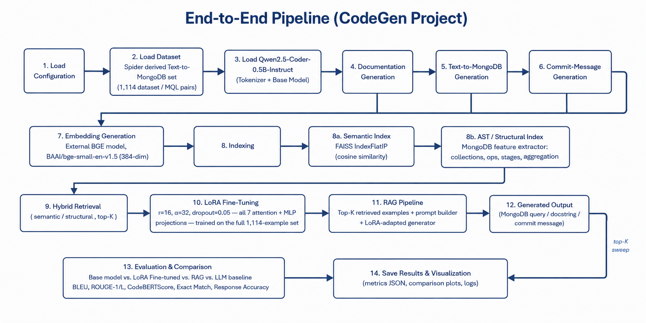
⇄
METHODOLOGY
Semantic Index
FAISS + bge-small
08 / 22

Slide 8
⊕
RETRIEVAL
Hybrid Retrieval Design
S
Semantic path (dense)
A
Structural path (AST-style)
Encode query with BAAI/bge-small-en-v1.5, L2-normalized.
Search FAISS IndexFlatIP (exact inner product = cosine) for the top 2×k nearest question/query pairs.
Captures intent — “how many…”, “average of…” — even across different wordings.
Regex-based feature extraction over MQL: collection:<name>, op:<find|aggregate|match|group…>.
Features indexed in an inverted index for fast structural lookup.
Captures query shape — an aggregate pipeline retrieves other aggregate pipelines.
score(doc) = 0.3 × norm(semantic_score) + 0.7 × norm(structural_score)
min-max normalized independently per query, top-k re-ranked from the merged pool
i
Why hybrid? Dense embeddings match meaning; structural features match MQL shape — combining both retrieves examples aligned on intent and syntax.
09 / 22

Slide 9
Δ
FINE-TUNING
LoRA Setup
Hyperparameter | Value
Rank (r) | 16
Alpha (α) | 32
Dropout | 0.05
Target modules | q/k/v/o_proj, gate/up/down_proj (full attn + MLP)
Trainable fraction | 100% of LoRA parameters
Batch size | 1
Learning rate | 2e-4
Epochs | 1
CAUSAL LM LOSS MASKING
prompt tokens — label = −100 (ignored)
completion tokens (MQL) — loss computed
### Task: Generate MongoDB Query (MQL)
### Question:
{question}
### MongoDB Query:
db.collection.find(…) ← loss here
Δ
A single-epoch LoRA pass adapts a 0.5B-parameter code model to MQL syntax across all 1,114 examples — loss is computed only on the query completion.
10 / 22

Slide 10
✓
EVALUATION
How We Measure Quality
Metric | What it measures | Notes
BLEU | n-gram precision vs. gold MQL (smoothed, corpus-level) | Tokenized on MQL punctuation
ROUGE-1 / ROUGE-L | Unigram / longest-common-subsequence overlap | F-measure, stemmed
CodeBERTScore | Semantic similarity via local CodeBERT embeddings (BERTScore F1) | Required fixing a silent num_layers bug that zeroed every score
Response Accuracy | Token-overlap recall: |gold ∩ pred| / |gold| | Lenient — not execution-based
Latency | Wall-clock ms per generated query | Measured end-to-end, GPU
!
11 / 22

Slide 11
Σ
RESULTS · 100-SAMPLE BENCHMARK
Generated Metrics : Baseline & Fine-tuned (LoRa)
Model | BLEU | CodeBERTScore | ROUGE-1 | ROUGE-L | Response_Accuracy | Avg_Latency_ms
Baseline | 0.0008 | 0.8004 | 0.2504 | 0.2263 | 0.3297 | 38890.28
Fine-tuned (LoRA) | 0.2019 | 0.8817 | 0.5360 | 0.4462 | 0.7624 | 54060.22
14 / 22

Slide 12
↑
RESULTS · 100-SAMPLE BENCHMARK
Fine-Tuning Impact
+0.201
BLEU (0.001 → 0.202)
+0.433
Response Accuracy (33% → 76%)
n=100
held-out questions
EVAL SET SIZE
Baseline | 100
Fine-tuned (LoRA) | 100
12 / 22

Slide 13
⏱
RESULTS · 100-SAMPLE BENCHMARK
Latency & Efficiency Trade-off
+39%
inference time added by LoRA adapters
13 / 22

Slide 14
◈
RESULTS · 5-SAMPLE QUICK EVAL
Base vs. LoRA vs. RAG Pipeline
Model | BLEU | ROUGE-1 | BERTScore | Resp. Acc. | Latency
Base Model | 0.226 | 0.560 | 0.876 | 0.952 | 20.4s
LoRA Model | 0.165 | 0.505 | 0.865 | 0.952 | 25.4s
RAG Pipeline | 0.004 | 0.241 | 0.769 | 0.629 | 33.9s
On this evaluation, adding retrieval hurts every single metric — RAG_Pipeline scores lowest on BLEU, ROUGE, BERTScore, and Response Accuracy, and is also the slowest of the three (33.9s vs. 20–25s).
!
RAG PIPELINE — 5-SAMPLE RUNS
Comparison | Examples
RAG Pipeline vs. Baseline (Base Model) | 5
RAG Pipeline vs. Fine-tuned (LoRA) | 5
Fine-tuned (LoRA), without RAG | 5
15 / 22

Slide 15
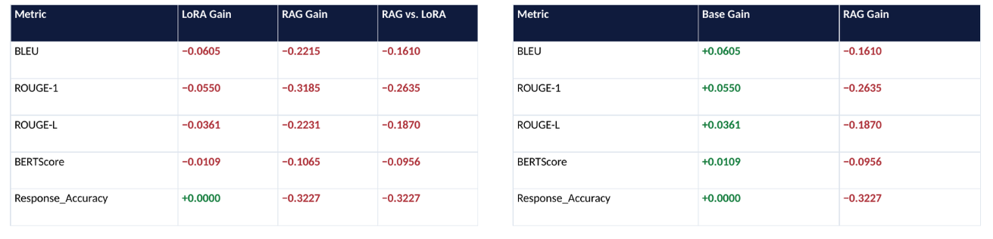
Δ
FINDING
Gain Analysis — Base, Fine-Tuned & RAG
Vs Base Model
Vs Fine Tuned(LoRa Model)
17 / 22

Slide 16
↓
FINDING
RAG Top-K Sweep
Top-K | BLEU | ROUGE-1 | BLEU Δ | ROUGE-1 Δ
1 | 0.0057 | 0.2694 | −0.204 | −0.230
2 (best) | 0.0081 | 0.2468 | −0.202 | −0.253
3 | 0.0023 | 0.1864 | −0.208 | −0.313
5 | 0.0056 | 0.1802 | −0.204 | −0.319
8 | 0.0067 | 0.2089 | −0.203 | −0.291
Best top_k by BLEU gain: k = 2 — but “best” still means “least harmful.” No k tested turns the gain positive.
Likely cause: retrieved few-shot examples add prompt-format drift for a model already specialized by LoRA on this exact distribution — retrieval competes with fine-tuning rather than complementing it. Measured on only 5 questions, so treat magnitudes as directional.
!
16 / 22

Slide 17
Q
RESULTS · QUALITATIVE
What Each Model Actually Generates
Question | Reference (gold) | Base Model | LoRA (fine-tuned) | RAG Pipeline
How many singers do we have? | db.singer.countDocuments() | db.actors.countDocuments()db.singer.aggregate([{$group:{_id:"count"}}, {$project… | db.actors.countDocuments()db.singer.aggregate([{$group:{_id:"count"}}, {$project… | db.actors.aggregate([{$group: {_id: "$Singer_ID"}}, {$count: "count"}])SELECT co…
What is the total number of singers? | db.singer.countDocuments() | db.actors.countDocuments()db.singer.aggregate([{$group:{_id:"count"}}, {$sum:_id… | db.actors.countDocuments()db.singer.aggregate([{$group: {_id: null, count: {$sum… | db.actors.aggregate([{$group: {_id: null}}, {$count: "sum"}]) # $group to aggreg…
Show name, country, age for all singers ordered by age from the oldest to the yo… | db.singer.find({}, {Name:1, Country:1, Age:1, _id:0}).sort({Age:-1}) | db.actors.find({}, {Name:1, Country:0, Age:-1}).sort({Age:-2})db.singer.aggr… | db.actors.find({}, {Name:1, Country:2, Age:3}).sort({Age:-1})db.singer.aggre… | db.averageround.aggregate([{"$addFields": {"sum_age": {$sum: "$age"}}},{"$divide…
19 / 22

Slide 18
+
BEYOND QUERY GENERATION
Auxiliary Capabilities
D
Documentation Generation
C
Commit Message Generation
5-shot prompted DocGenerator turns a code snippet into a natural-language docstring.
CommitMessageGenerator writes conventional commit messages (feat / fix / docs…) directly from a git diff.
def calculate_area(radius):
return 3.14159 * radius ** 2
→ “Calculates the area of a circle
given its radius.”
diff --git a/auth.py b/auth.py
+ def refresh_token(user):
+ …
→ “feat: add token refresh
handling for auth flow”
i
The same GenerationPipeline is reused across tasks — only the prompt template changes — showing the fine-tuned adapter's utility isn't limited to MQL generation.
18 / 22

Slide 19
T
WITH THANKS
Acknowledgments
♦
Sajid Ansari
Project Mentor — for technical mentorship on the RAG and fine-tuning design.
♦
♦
IIIT Hyderabad & NSE TalentSprint
For the E-Masters program structure, curriculum, and computing resources.
♦
Open-source & dataset providers
Spider (Yu et al.), Qwen Team, HuggingFace PEFT/Transformers, FAISS, and BAAI (BGE embeddings) — the tooling this project builds on.
♦
Group 2 teammates
N Anjan Karthik Chandra, Jakka Rithusravya and Darshna Kumawat — for collaboration across data prep, modeling, and evaluation.
21 / 22

Slide 20
Thank You
22 / 22

